Slide 1
Theory of change in 30 minutes
James Noble, Theo Clay September 2019
Notes:
Survey
1) Talk through some of the basics – partly for those new to this, but also to share our views on some of the underlying things around theory of change
2) Open-up for discussion
3) Summarise some aspects of our latest thinking.
Maybe not rethink but clarify, deal with some of the problems / pitfalls.

Slide 2
Brief INTRODUCTION TO THEORY OF CHANGE

Slide 3
“Theory of change?”
A process for thinking about and describing programmes, projects or organisations
Outcome Framework
Planning Triangle
Log Frame
Programme Theory
Theory of Change
Logic Model
Outcomes Map
Story of Change
Notes:
Theory of change has been around for a while. There are lots of variations which go by different names – but they are essentially the same thing.
Variation tends to relate to how you present the output of the process.
It is a bit unfortunate that we have these different names because I think it tends to confuse people and make this process more complicated than it needs to be.

Slide 4
It describes your theory of how you plan to cause change in the world.
- A statement of what you want to happen—a hypothesis.
- Applicable to programmes, projects, organisations – anything that is aiming to ‘do good’
- A precursor to more detailed project planning - which comes later.
Notes:
Change in the world – how you plan or hope to achieve social value. Hope. No implication that this is what does happen.
Flexibility – although what you apply it to has significant implications for what the process and output looks like.
Inputs / outputs / funding arrangements / plans for organisations growth or scale / targets / performance indicators. All later

Slide 5
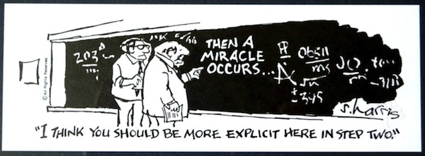
Challenges us to Open-up our thinking about how projects are meant to work. Fills in the gaps.
?
Mentoring Reduction in youth unemployment
Research Policy change
Campaigning Changes in public opinion
Notes:
Key insight is encouraging people to think through exactly how what they are doing makes the change. Addresses lack of rigor or rationality associated with charities efforts.
"Philosophers have hitherto only interpreted the world in various ways; the point is to change it"

Slide 6
The process Can be as important as the end result
Theory of change
External research / data / good practice
Consultation with colleagues, beneficiaries and other stakeholders
Someone to lead & work towards consensus
Willingness to reflect and challenge ourselves: Why do we think that?

Slide 7
A structured process
Breaking up ideas standard components, which are intended to be useful
Components addresses in sequence. ‘Backwards mapping’
Aim to identify the sequence or journey of change (where possible)
Often summarised / represented as a diagram (optional)
1 Context / Situation
2 Target groups
s
“Accountability line”
5) Activities
6) Mechanisms
4) Outcomes
3) Impact
The ways in which you want your target groups to engage with your activities to maximise the likelihood of outcomes being achieved.
Change in your target groups that you think will contribute to impact:
Changes in knowledge, skills, attitudes and / or behaviours.
The sustained effect that you want to achieve. Amongst; a) your target groups; and then b) the community as-a-whole
What
you plan to do:
How much and with
what quality?
Notes:
Where possible – sequence not always applicable
Diagram optional – theory of change is not simply a diagram

Slide 8
benefits of Theories of Change
Project design / review: A forum that encourages people to challenge themselves; review the evidence base; and think seriously about context, priorities and plans. Leading to stronger underlying thinking – and better projects.
Strengthening teams and team motivation through;
Dialogue and debate: Bringing people together to share their views and experiences Leading to better understanding between colleagues, inclusion of a wide spectrum of views and greater buy-in / commitment.
Clarity: Working towards succinct / consistent plans. Leading to a greater strength of purpose and team motivation
Better monitoring and evaluation through;
Improved monitoring and evaluation plans: A blueprint for what needs to be measured and identifying research priorities. Leading to better quality evaluations
Frameworks for performance assessment and reporting: Identifying shorter-term indicators of success and the basis for a narrative about project effectiveness. Leading to more timely and robust accounts of project effectiveness
Better external communications and better conversations with partners: A tool for showing project aims quickly and showing that the ‘change process’ has been thought through. Leading to wider understanding and confidence
Notes:
Developmental or descriptive modes

Slide 9
How to do it

Slide 10
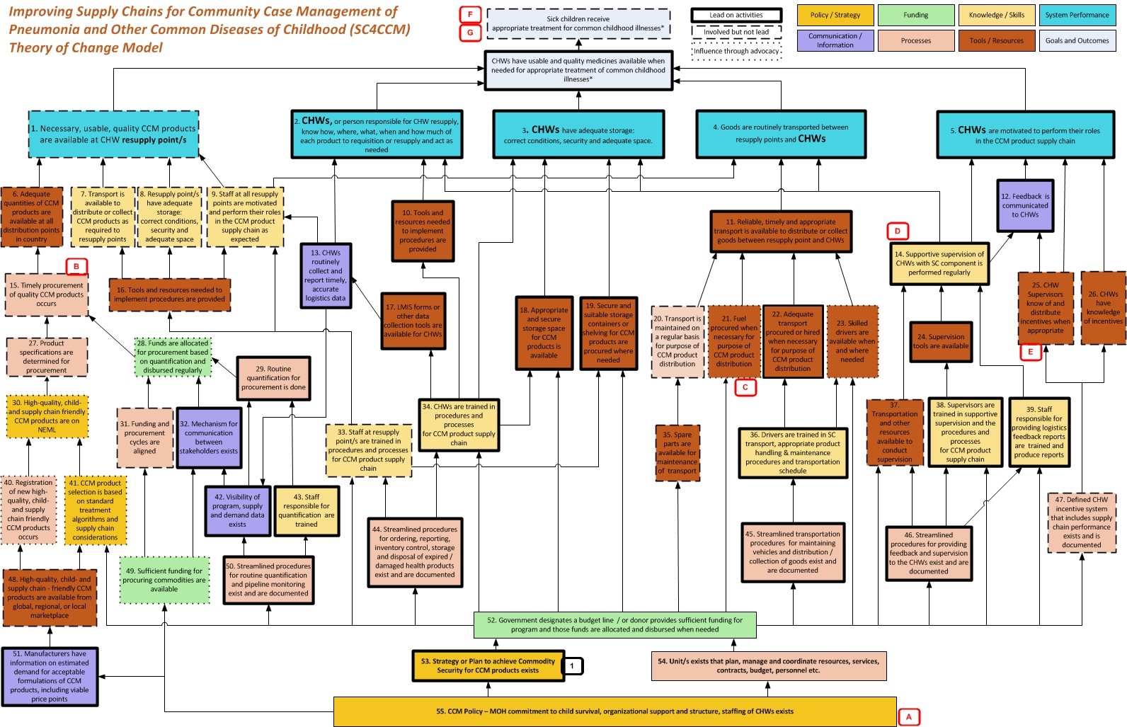
The key challenge: Theory of change is a simple notion but the world we live in is complex
Notes:
Key practical problem

Slide 11
Theory of change as a ‘three stage’ / ‘10 step’ process
Situation analysis:
Define; the issue you want to tackle; wider context; the resources you have to tackle it; and who you want to work with.
Theory of change:
Describe what you want to achieve and how you plan to achieve it
Assumptions:
Consider how the external environment will affect things and where the theory of change weak, uncertain or untested.
1) Situation Analysis
2) Target group (s)
3) Impact
4) Outcomes
5) Activities
6) Mechanisms / quality
7) Sequencing
8) Diagram
9) Enabling factors
10) Weaknesses / risks
Notes:
We have a ten step guide to doing a theory of change. Higher level
Sandwiched between two critical things – SA and Assumptions
Target group in bold, to remind us that steps 2 – 6 need to be done for each target group

Slide 12
Step 1: Situation Analysis
Prompts to work through
Firstly, define your ‘problem’ in a few words
What’s the scale of the problem?
Who is affected?
What are the consequences?
What are the causes?
What are the barriers to success / change?
What are the opportunities to overcome these barriers?
Who else is working to tackle the problem?
What is not happening? What are the gaps?
What resources do you have to tackle the problem?
- Given your resources, what, broadly, will we do? What’s the best course of action? Where might you make the most difference?
- What options, strategies or approaches are we ruling out?
Notes:
Part of the process that’s sometimes skipped – but we argue that it’s always useful to take stock and reflect.
Try to put aside, or suspend, thinking about your own project or organisation and just think about the situation / problem itself.
Situation analysis is greatly enhanced if it is based on:
Research / data / evidence
Consultation with stakeholders / users / beneficiaries

Slide 13
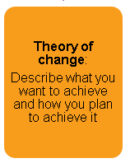
Theory of change
Context: - The nature, scale, causes and consequences of the problem.
The characteristics and needs of your chosen target group
The things that affect them
Target Group: Prisoners aged 18-24, substance misuse issues, no acute mental health problems, due for release within next 6 months.
“Accountability line”
Providing mentoring support to 20 people using community volunteers
Comes back
Listens / feels listened to
Engages
Trusts
Better understands their situation
Imagines different future
- Make small changes
- Engages in other services
- Decrease drug & alcohol use
Reduced reoffending
Better health / wellbeing
Employment
4) Activities / quality. What is delivered, how much and with what quality? What is distinctive service
5) Mechanism of change: The process through which people engage with and benefit from the activities of the programme
3) Intermediate outcomes are the assets, strengths, capabilities etc. that programmes convey to people so they achieve impact for themselves
2) Impact: The sustained effect on families, individuals and communities that we want to see.
Notes:
So here is an example theory of change based a number we have done for criminal justice organisations over the years
We start the process by discussing the context. Which means thinking about the social issue we want to tackle, the causes of the issue, who else is working on it, and importantly who we want to work with to tackle it. In other words, our target group.
We then move to describing the impact. Which is defined as the sustained, long-term effect we want to see in the world. Which our service users will achieve for themselves – they will live their lives in their communities
Next we think about shorter-term or intermediate outcomes. These are the assets or capabilities we want to give people which we think will help them achieve the impact.
We then talk about activities, essentially what we are doing and how much?
And finally, it’s the interesting part. Which is what do we think it is about these activities that will achieve the outcomes we are looking for? For, me this is the heart of the theory of change, which we refer to as ‘mechanisms’.
********************************
So what is the point? Well I think we can group the benefits under three headings.
Firstly evaluation, and it’s the obvious point that until you know what something is trying to achieve—and how—you cannot evaluate it.
An evaluation is about testing the extent to which this happens in the real world, so its illogical to do an evaluation plan without a theory of change. The best evaluations actually draw on the challenges or assumptions stage of the process, because this is where we work out where the model is weakest and therefore what you most need to investigate.
As well as helping you with your evaluation plans, a theory of change can also help you write-up your findings. Essentially, presenting evidence against each of these components is the best way to construct a persuasive narrative about whether the programme has made a difference.
The next benefit is that a theory of change can be used to quickly communicate about a programme - for example to potential funders.
And the third main benefit, is what we loosely call ‘strategy’.
Basically, done in the right way, and with the right people in the room, a theory of change process is a good forum for asking important questions and getting teams to a common understanding.
In our work with charities, just getting everyone to an agreed impact statement can be really valuable. And once they have done this, charities will often realise they are doing things that don’t help, or they’re not doing other things that might.

Slide 14
Step 2: Define Target group (s)
Target groups are the people or institutions you want to reach or work with through your project.
Tips on defining target groups:
Can include:
Systems: Policy makers, institutions, organisations – and the way they operate together
Institutions: prisons, local authorities, community organisations, funders
Beneficiaries / those affected by the ‘problem’: people in the justice system, their children, communities
Be as precise as you can in defining target groups. For example
Care leavers aged 18-24, NEET, some contact with criminal justice system, unstable housing situations, lacking positive role models.
Magistrates with limited legal knowledge / experienced who make more custodial sentences than average.
Try to identify factors most connected to your ‘problem’. Consider:
Objective factors – age, location, education, offending / personal histories.
Subjective factors – knowledge, attitudes and behaviours.

Slide 15
3: What does impact mean?
Impact: The sustained effect that you want to achieve.
Amongst; a) your target groups; and / or b) the community as-a-whole.
Tips on defining impact:
Long-term, potentially something that’s achieved after your programme. e.g how do you want the world to better off in five years time because of your work?
Something important and meaningful: reduced offending, increased employment, improved wellbeing
Succinct as possible: 1 or 2 sentences
Clear, jargon free and intelligible:
Something that people achieve for themselves. After your work is finished
Something you are likely to contribute to alongside others
- Think about the impacts you want to achieve amongst the target groups (individuals and institutions) you have defined above
Notes:
One target group at a time. A key thing about impact is that is about the people or environment you aim to reach or serve. So you need to start by agreeing who these people are, and you need to do these for each target group.
Amongst the organisations I’m working with at the moment target groups include disadvantaged young people, people with specific health problems, people at risk at homelessness.
But it can also be whole communities – for example, a museum or church might seek to engage everyone and that’s fine.
It
can also be professionals or organisations. For example, we have some VCS infrastructure organisations in the room – so their target group is other organisations
Long-term. Sustained. Five years. There are some charities where this doesn’t work so well. For example if you are supporting people whose health is particularly bad. But you can still think in terms of your legacy – after you have delivered your service what are people left with. What is sustained?
Something that a funder or commissioner will be willing to be pay for.
It’s an important but subtle point that, that ultimately whether people are happier, healthier, whether they get employment or, feel part of their community is up to them. Charities contribute to these changes through providing opportunities, support and encouragement. So it’s best to think of impact as a change people make and sustain themselves.
Because impact is a profound change – I’d argue that organizations should only really have a couple of impact statements. It’s good to have a clear focus
What I’d like you to do is spend a couple of minutes thinking about your organization and these two questions… And I’ll get a couple of examples from the room.
Get everyone to think about their impact and get a few from the room.
Highlight how impact is very different organisations

Slide 16
4: What shorter-term outcomes Do you want to achieve?
What changes in your target audience do you think will contribute to the impact / ultimate goals you have defined
Tips on thinking about short-term outcomes
They relate to how you want your service users to be changed by your work.
What resources, assets, strengths, capabilities will your programme give people
It can help to think separately about shorter-term changes in
a) Knowledge/skills
b) Attitudes
c) Behaviours
Use ‘change’ words:
Improved
Reduced
Increased
Start with a brainstorm, then try to whittle them down
Make sure you state which target group they relate to
Try it yourselves…

Slide 17
5: What are your activities?
Usually the easiest part. What are you doing (or going to do?)
Tips on thinking about activities
Describe what your project does (or what you want it to do)
Use language of activities and interventions:
Provide
Support
Run
Offer
A good description will describe the most important features.
What are you offering? What activities
What will people be doing? How often? For how long?
What are the key features?
How will recruit or attract your target group?
Try it yourselves…
Notes:
Next think about the activities your project delivers – describing important features such as what you’re offering, how you will get people involved, how should people engage with it, what will people be doing.
Think about language – provide, support, run, offer.

Slide 18
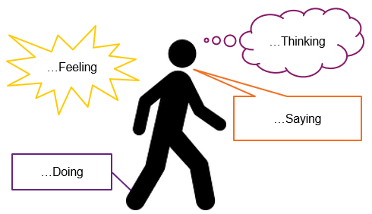
6: How to develop Mechanisms of change
How do you think your activities work to produce the short-term outcomes you have defined above?
Tips on thinking about mechanisms:
This is a bit harder: Describe the ways in which you want people to engage with your project. Think about what ‘good quality’ will look like.
It helps to imagine how you want people to experience your project as it happens / ‘on the day’ / in the moment
Often relates to feeling motivated, listening, engaging, enjoying, relevance, trust.
Think about what your target groups/users will be….
….whilst they are engaging with your project.
Notes:
Finally, thinking about what we call ‘mechanisms of change’ – how your activities will produce the short-term outcomes you’ve defined.
This can be tricky but it’s about describing the ways in which you want people to engage with your project.
It can be helpful to imagine what the ideal experience of your project would be ‘on the day’.
Going back to the maths club example, an activity would be the right young person coming to the club and participating. An outcome is they are motivated to study and learn. And mechanisms could be they listen, they enjoy the club, they concentrate, and they feel like they are making progress.

Slide 19
Step 7: Sequencing
1) Stuck / Denial / Despair
Leave me alone, I’m ok as I am OR I can’t change
2) Just managing
Someone has to help me most of the time. I need prompts and advice to manage
3) Safe and stabilised
I’m starting to sort things out (benefits, probation appointments, rent, substance use not out of hand)
4) Understand self and possibilities for change
I can change and I know it’s up to me to take responsibility, but I still need some help
5) Raised aspirations and made plans
I’ve started to change my behaviour & lifestyle, and take control of my own life
6) Work towards plans with support
I’m really learning how to do this, and I’ll keep on doing it
7) Working Independently
I have a plan and I’m working towards it without support. Maybe learning / other opportunities. Pro social behaviours.
8) Self-reliant
I can manage without help. I might even be able to help others
Notes:
We have found that in CJ it helps to think about a journey and build the ToC around this.

Slide 20
Logic model for restorative justice intervention
Step 8: Diagram - basic logic model
Positive perceptions and trust of local services and staff members
- Engage and talk to young people and agree how they might make amends
Restorative conversations focussing on what happened, why it happened and what could be done to put it right
Mediation between victim and offender
Reparation activities (panels, apology letters)
Involvement of parents and carers
Trust staff and see them as credible
Better understand / feel regret for impact of crime on victims
Listen to new ideas and ways
of thinking
Understand consequence
of actions (both positive and
negative)
New ideas seen as personally relevant & generate emotional response
↑ Ability to relate to others
↑ Trust in adults
More negative attitudes to anti-social & criminal behaviour and drug use
Take responsibility for past
actions and for the need to change
↑ Increasing self-worth
↑ wellbeing
Referral to other support services (substance misuse, training, counselling, anger management etc.)
Address other barriers other lives and increase capacity for change
↑ Change in identity from criminal to positive member of society
More positive social attachments
Decision to move away from negative behaviour
↑ Positive feelings about the future
Graduate with feeling of achievement & affirming their new
outlook
Meeting and ‘celebration’ to mark the end of the process
Attendance/engagement at school
Activity
Mechanisms
Intermediate outcomes
Impact
Notes:
Make point about victims not included here

Slide 21
Theory of change based around a ‘journey’: restorative justice intervention
Step 8: Diagram – now expressed as a journey
Referral to other support services (substance misuse, training, counselling, anger management etc.)
Positive perceptions and trust of local services and staff members
- Engage and talk to young people and agree how they might make amends
Restorative conversations focussing on what happened, why it happened and what could be done to put it right
Mediation between victim and offender
Reparation activities (panels, apology letters)
Involvement of parents and carers
Meeting and ‘celebration’ to mark the end of the process
More negative attitudes to anti-social & criminal behaviour and drug use
Trust staff and see them as credible
Listen to new ideas and ways
of thinking
New ideas seen as personally relevant & generate emotional response
Take responsibility for past
actions and for the need to change
Address other barriers other lives and increase capacity for change
Graduate with feeling of achievement & affirming their new
outlook
More positive social attachments
↑ Ability to relate to others
↑ Trust in adults
Understand consequence
of actions (both positive and
negative)
Better understand / feel regret for impact of crime on victims
Decision to move away from negative behaviour
↑ Positive feelings about the future
↑ Increasing self-worth
↑ wellbeing
↑ Change in identity from criminal to positive member of society
Attendance/engagement at school
Activity
Mechanisms
Intermediate outcomes
Impact
Notes:
Make point about victims not included here

Slide 22
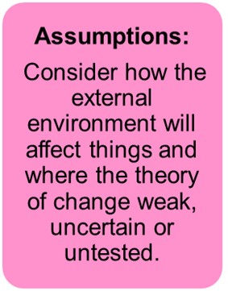
Steps 9 / 10: Assumptions - Challenge your theory of change:
Context assumptions: What external things could effect the way this works? (help or hinder)
Other professionals working with us so that activities are linked
Other organisations not do things to undermine us
What conditions will support success?
Delivery assumptions: What do we need to do to deliver effectively?
Staff will have sufficient capacity / capability to make it work
We can identify and reach people in our target group
Impact assumptions: Assuming everything goes to plan, what are key questions or concerns we still have about whether this will work?
For whom will it be most successful? What characteristics will determine success
This activity is sufficient to address the problem identified
Possible negative / unintended consequences?
What could go wrong? How might people respond negatively?
Will our activities distract or take resources from something else?

Slide 23
Example: Private rented sector housing provision
Assumptions about context. How will the wider environment affect us?
Suitable properties exist for the Association to rent out, available at the right price
Wider society will accept homeless people There is appropriate housing for residents to move into
The right opportunities exist within society, so that if residents follow advice and take responsibility for themselves they will achieve their goals
Assumptions about viability. Can we deliver?
The support we are funded to provide is enough to achieve to deliver a quality services
It is financially viable to identify, set up and maintain properties
Assumptions about our service users. Is the theory valid?
A key assumption is that residents have the potential for attitudinal change
The experience of living securely, with low levels of personal support is enough to create a positive mind-set for change
It is ultimately possible for homeless people to live independently and be part of society—and the level of support provided is sufficient to help them do that
Possible negative / unintended consequences?
That residents don’t cause harm (perceived or otherwise) within their communities
That residents don’t become dependent upon our support
Notes:
These are Derventios research priorities

Slide 24
Theory of change → Data collection
5 types of data | Key questions
1) “User”: The characteristics of the people you reach | - Is the service effective at reaching the target group? - What else is going on their lives that might affect their engagement, outcomes, impact?
2) “Engagement”: The extent to which people use the service. How often and for how long? | - Is the service effective at retaining the target group and delivering the intended service with them?
3) “Feedback”: What the service is like for service users, how they choose to engage with it? | - What do users (and non-users) say about the service? - What they are thinking, feeling, saying and doing whilst using the service? - How could it be better?
4) “Outcomes”: Short term changes or benefits for people (eg changes in knowledge, attitudes and behaviour) | - In what ways to people appear to benefit from the service / campaign? - Do they start to make the positive changes you intend?
5) “Impact ”: Sustained change - achieved by people for themselves | - Are positive changes sustained? - Does it lead to more tangible effects? - Can you attribute this to you service?
Frequency?
Routine
Occasional
Exceptional
https://www.thinknpc.org/blog/5-types-of-data-for-assessing-your-work-an-explainer/
Notes:
Why routine?
Easier
Early warning signs
Evidence already exists

Slide 25
James.noble@thinknpc.org theo.clay@thinknpc.org
September 2019

Slide 26
Illustration: Some themes from the Existing evidence base
Hopeful about giving up crime
Pro-social problem solving skills
Reduced alcohol use
Increased employability
Intermediate outcomes
What?
How?
Holistic interventions that address multiple criminogenic needs
Pro-social recreational activities
Structured cognitive behavioural programmes
Practical support
Risks, needs, responsivity
Personal choice – decision to desist
Appropriately sequenced services
Individual structured counselling and behaviour programmes
Trusting relationship with an offender manager
Motivational and engaging, rather than control oriented
Engaging offenders in setting goals for supervision
Improved social/family ties
Non-criminal peer groups
Housing stability
Developing non-criminal identity
Pro-social lifestyle
Drawn from: What Works to Reduce Reoffending: A Summary of the Evidence http://www.gov.scot/Resource/0038/00385880.pdf
Notes:
One further point is that, as well as getting the views of your team, your theory of change also needs to show how your work relates to the existing evidence base. As we understand it ,your grant application will be much stronger if you can show this.
There is actually a very rich evidence base for criminal justice, more so than in other topic areas we work in – like youth for example.
There have also been lots of attempts to summarise the evidence base, as this slide shows. It’s a one slide summary of a review done by the Scottish Government a few years ago.
Our suggestion is both to bring this evidence into the development of the theory of change, and include references to the evidence base it. And if you look at the example we linked to in slide 7, you can see how we have attempted that,

